Slide 1
Netskope – Deployment
Architectures

Slide 2
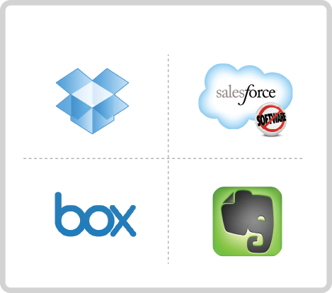
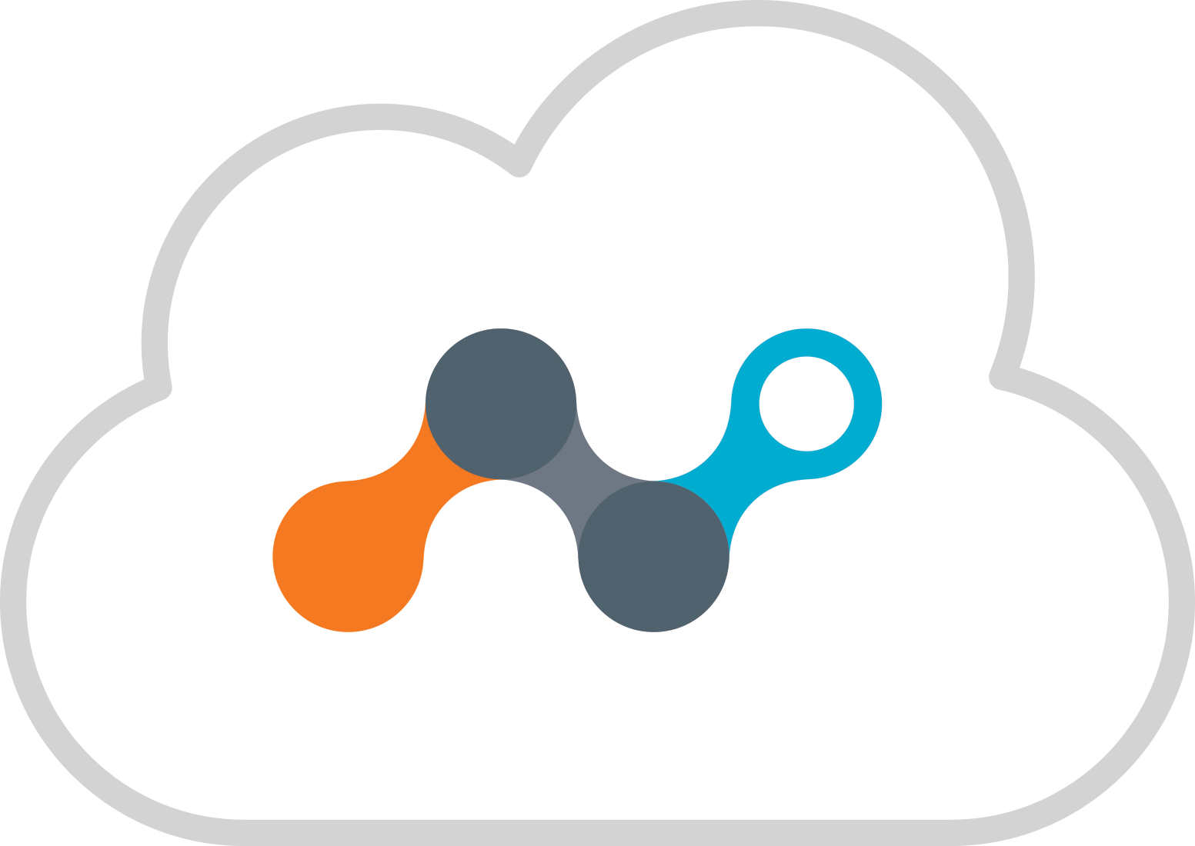


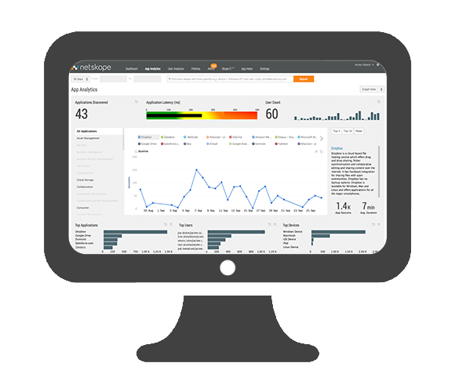
Flexible Deployment Architecture – 3 Steps
1. Netskope will create private SaaS cloud tenant https://company.region.goskope.com
2. Setup deployment modes to steer cloud app traffic using a variety of flexible methods
3. Perform analysis and enforce policy
PUBLIC CLOUD APPS
Customer Tenant
Admin Console
Notes:
Netskope is deployed primary as a service with per user, per month subscription pricing. The first step after signing up for the service is that you get access to a private cloud tenant. The next step is cloud app traffic is steered to your tenant using a variety of flexible deployment options, which I will cover in the next slide. That enables Netskope to perform analysis and policy enforcement.

Slide 3
Deployments that work together to fulfill use cases comprehensively
Offline
Inline
LOG
API
Connector
Reverse
Forward
Proxy
Proxy
Explicit Proxy
Proxy Chaining
DNS
Client Agent
Cloud app discovery
App risk
Basic activity visibility
eDiscovery of DLP violations
Data governance
Policy control for at rest content
Real-time policy control for browser based sanctioned cloud apps only
traffic steering options
Real-time policy control for all cloud apps
Native, browser and mobile app coverage
Mobile and remote coverage for all cloud apps
Use Cases

Slide 4


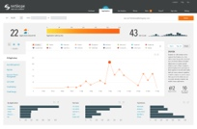



Discovery – Option 1 - Static Log Upload
LOG
Netskope
GoSkope.com
(Normally used for POC Only) Transfer of logs from existing network platforms such as Firewalls & Web Proxies to provide application discovery
Active
Customer
Manual Upload via CLI or UI
a
LOG DATA
SFTP
On-premise users

Slide 5


Discovery – Option 2a Virtual Appliance, On Premise Log Parser
LOG
Netskope
GoSkope.com
Automated Transfer of logs from existing network platforms such as Firewalls & Web Proxies via local virtual appliance
Active
Customer
AD
Server
AD
Connector
VA-01
Encrypted file upload with encrypted field obfuscation
a
LOG DATA
Continuous Log Feed
On-premise users

Slide 6
Discovery – Option 2a Virtual Appliance, On Premise Log Parser
LOG
Netskope
GoSkope.com
Automated Transfer of logs from existing network platforms such as Firewalls & Web Proxies via local virtual appliance
Active
Customer
AD
Server
AD
Connector
VA-01
Encrypted file upload with encrypted field obfuscation
a
LOG DATA
Continuous Log Feed
On-premise users

Slide 7
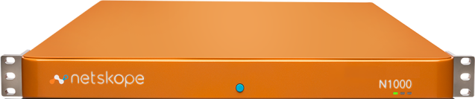
Discovery – Option 2b Hardware Appliance, On Premise Log Parser
LOG
Netskope
GoSkope.com
Automated Transfer of logs from existing network platforms such as Firewalls & Web Proxies via local hardware appliance
Active
Customer
AD
Server
AD
Connector
Netskope Appliance
Nx000
Encrypted file upload with encrypted field obfuscation
a
LOG DATA
Continuous Log Feed
On-premise users

Slide 8
Discovery, Option3 - On Premises Processing & Reporting, Netskope Appliance’s
LOG
Netskope
GoSkope.com
Local log processing of logs data from Firewalls & Web Proxies via on premises standalone appliances, Log processing and Reporting
Active
Customer
Netskope Appliance
Management & Reporting
Netskope Appliance
Log Processor
LOG DATA
a
On-premise users

Slide 9



Offline Application Data Management Introspection – Application API
API
Connector
Netskope
GoSkope.com
Authenticated App API for data discovery, exposure measurement and reactive control
Active
App
API
Mobile users
Customer
Retrospective Audit and Control
Admin
API
On-premise users
Off-premise users

Slide 10
Active Inline Enforcement Option 1 Secure Forwarder Proxy
Forward
Proxy
Netskope
GoSkope.com
Active deployment with transparent forwarding via locally deployed virtual appliance “Secure Forwarder”, via client Proxy Pac or DNS redirection
Active
Customer
VA-01
Cloud traffic steering for targeted App for active session & data control
On-premise users

Slide 11
Active Inline Enforcement Option 2 Netskope Appliance (data plane on premise)
Forward
Proxy
Netskope
GoSkope.com
Active deployment with transparent forwarding via locally deployed appliance, data plane in premise for local enforcement, via client Proxy Pac or DNS redirection
Active
Management plane in Cloud
Customer
Data plane on premise
Netskope Appliance
Nx000
On-premise users

Slide 12
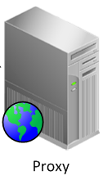
Active Inline Enforcement Option 3 Proxy Chaining
Proxy
Chaining
PROXY
Netskope
GoSkope.com
Active deployment with transparent forwarding via local proxy to Netskope Active Cloud tenant
Active
Customer
Forwarding Cloud Traffic
Selective Cloud App Traffic Steering
Explicit Cloud Proxy
On-premise users
General
Web Traffic

Slide 13
Active Inline Enforcement Option 4 Client Agent Forwarder
Thin Agent
Mobile Profile
Netskope
GoSkope.com
NS Client
Active
Active forwarding with device App to transparently redirect managed applications
Mobile users
Active traffic forwarding over secure connection
NS Client
NS Client
On-premise users
Off-premise users

Slide 14
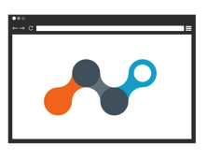
Active Inline Enforcement Option 5 Unmanaged Device - Agentless (Reverse Proxy)
Reverse
Proxy
Netskope
GoSkope.com
Auth
Proxy
Reverse Proxy
Active
SAML/ADFS
IdP
3
4
Reverse proxy for SAML/ADFS Authenticated Applications for agentless redirection for targeted Applications
Browser access to Sanctioned App
1/ Initial request to App
2/ App redirects user to its IdP: NS Auth Proxy
3/ NS Auth Proxy obtain assetions from original IdP
4/ NS Auth Proxy redirect user, with assertions, to NS RProxy
5/ User request forwarded to App via Active platform
5
2
Proactive passive control to non managed devices
1
Browser

Slide 15
Active Inline Enforcement Managed Device - Agent (Forward Proxy)
Forward
Proxy
Netskope
GoSkope.com
Auth
Proxy
Forward Proxy
Active
SAML/ADFS
IdP
5
4
Client
GWY
3
Forward proxy for Authenticated Applications for agent forwarding
Browser access to Sanctioned App
1/ Initial request to App – Traffic is tunneled to NS Gateway
2/ Traffic is forwarded to the target App
3/ Auth response from the App is sent to the IDP (NS Auth Proxy)
4/ NS Auth Proxy forwards Auth request to IDP for validation
5/ Authenticated flow is forwarded via the Forward proxy to the App
2
1

